Slide 1
Weather vs Climate what’s the difference?
If you don’t like the weather:
  Wait five minutes!
If you don’t like the climate:
  Move!

Slide 2
Location! Location! Location!
Climate is Place
Depends on where you live:
  Latitude!
  Altitude (mountains vs valley)
  What’s upwind (ocean vs land)
Changes very slowly
Very predictable
We can predict that Miami is warmer than Minneapolis for precisely the same reasons that we can predict a warmer future!

Slide 3

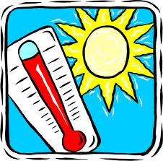
Ever Wonder Why?
Day is warmer than night
Summer is warmer than winter
Miami is warmer than Minneapolis

Slide 4

Heat Budgets
Heat in
Heat in
Heat out
Heat out

Slide 5
Dancing Molecules and Heat Rays!
Nearly all of the air is made of oxygen (O₂) and nitrogen (N₂) in which two atoms of the same element share electrons
Infrared (heat) energy radiated up from the surface can be absorbed by these molecules, but not very well
O
O
N
N
Diatomic molecules can vibrate back and forth like balls on a spring, but the ends are identical

Slide 6
Dancing Molecules and Heat Rays!
Carbon dioxide (CO₂) and water vapor (H₂O) are different!
They have many more ways to vibrate and rotate, so they are very good at absorbing and emitting infrared (heat) radiation
O
C
O
O
H
H
Molecules that have many ways to wiggle are called “Greenhouse” molecules
Absorption spectrum of CO2 was measured by John Tyndall in 1863

Slide 7
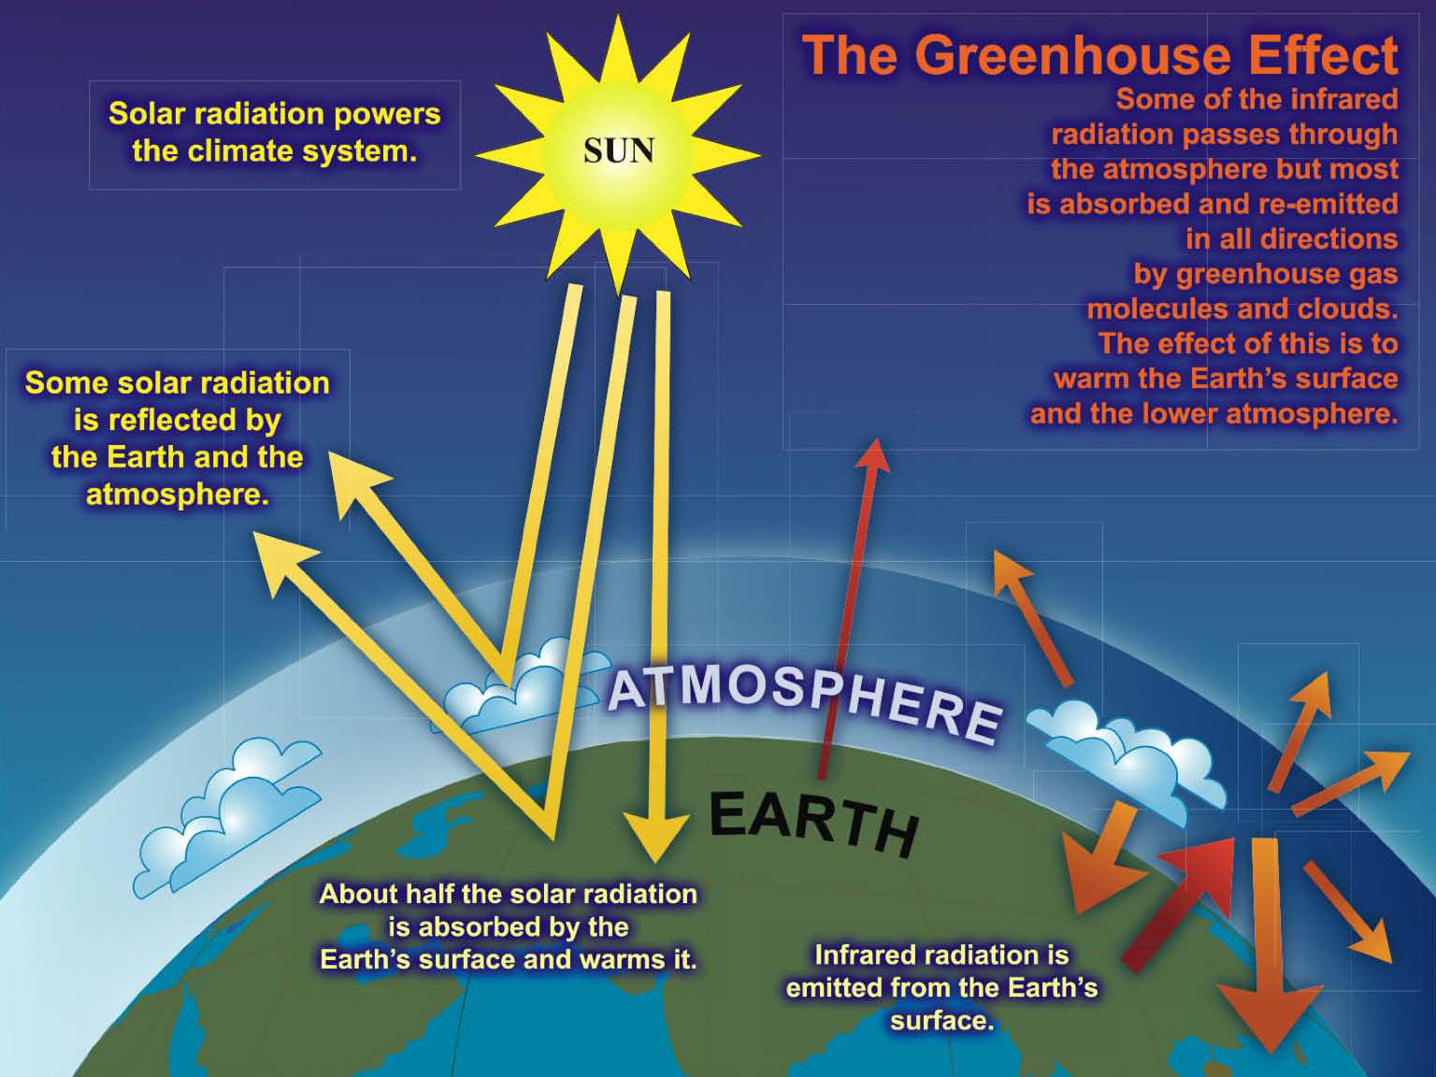

Slide 8
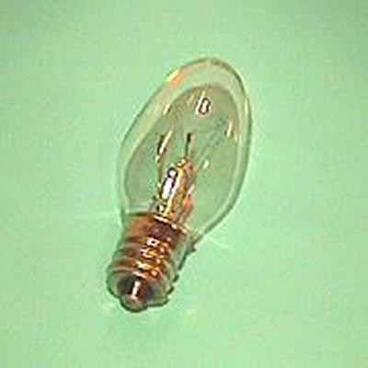
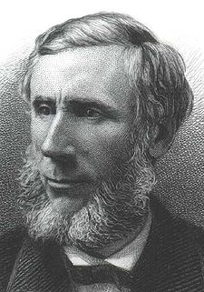
Common Sense
1 m
Doubling CO₂ would add 4 watts to every square meter of the surface of the Earth, 24/7
Doing that would make the surface warmer
This was known before light bulbs were invented!
4 Watts
1 m
John Tyndall, January 1863

Slide 9
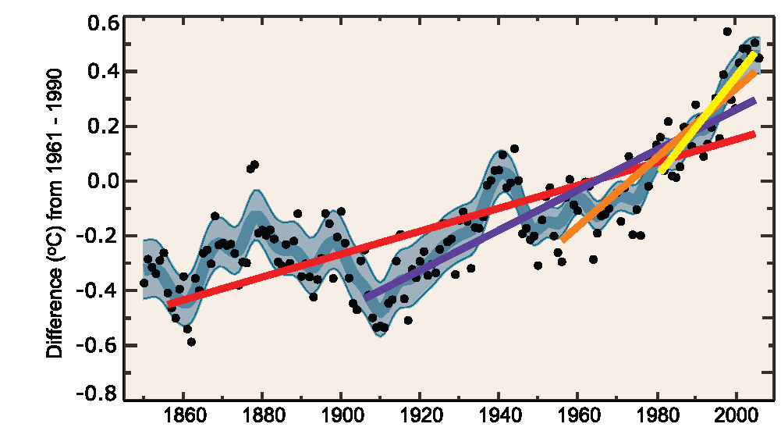
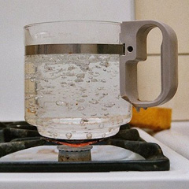
Common Myth #1
“People are worried about climate change because it’s been getting warmer lately”
WRONG! We’re concerned because we know that when we add energy to things, they warm up

Slide 10
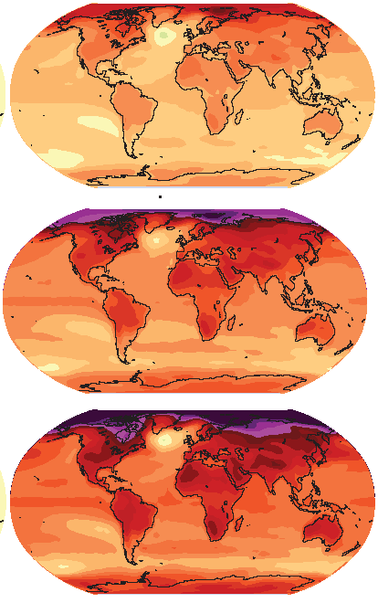

How much warmer?
Land vs ocean!
North vs South
Global mean
warming of 2º to 5º C
North American
warming of 3º to 6º C
= 5º to 11º F
Arctic warming of
8º to 14º F
Low
Emissions
Moderate
Emissions
High
Emissions
Rainfall? Agriculture?
Water supply? Ski industry?
Mass immigration?

Slide 11
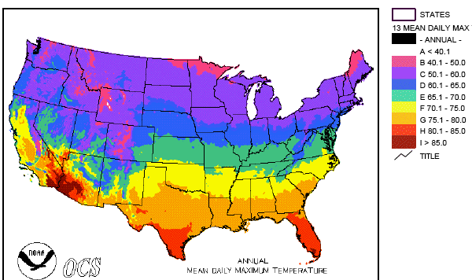
Where is it 10°F Warmer
“on average?”
Denver ➔
Amarillo
Grand Junction ➔ Tucson
Illinois ➔
Mississippi
Water? Crops?
Real Estate? Health?

Slide 12
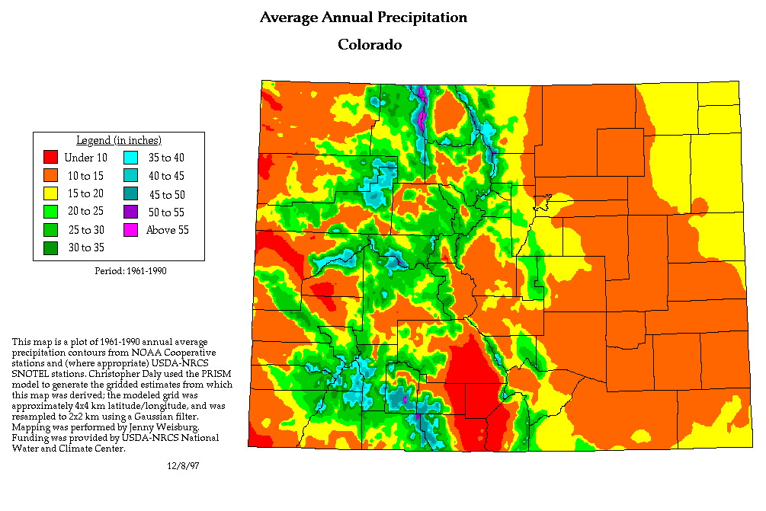
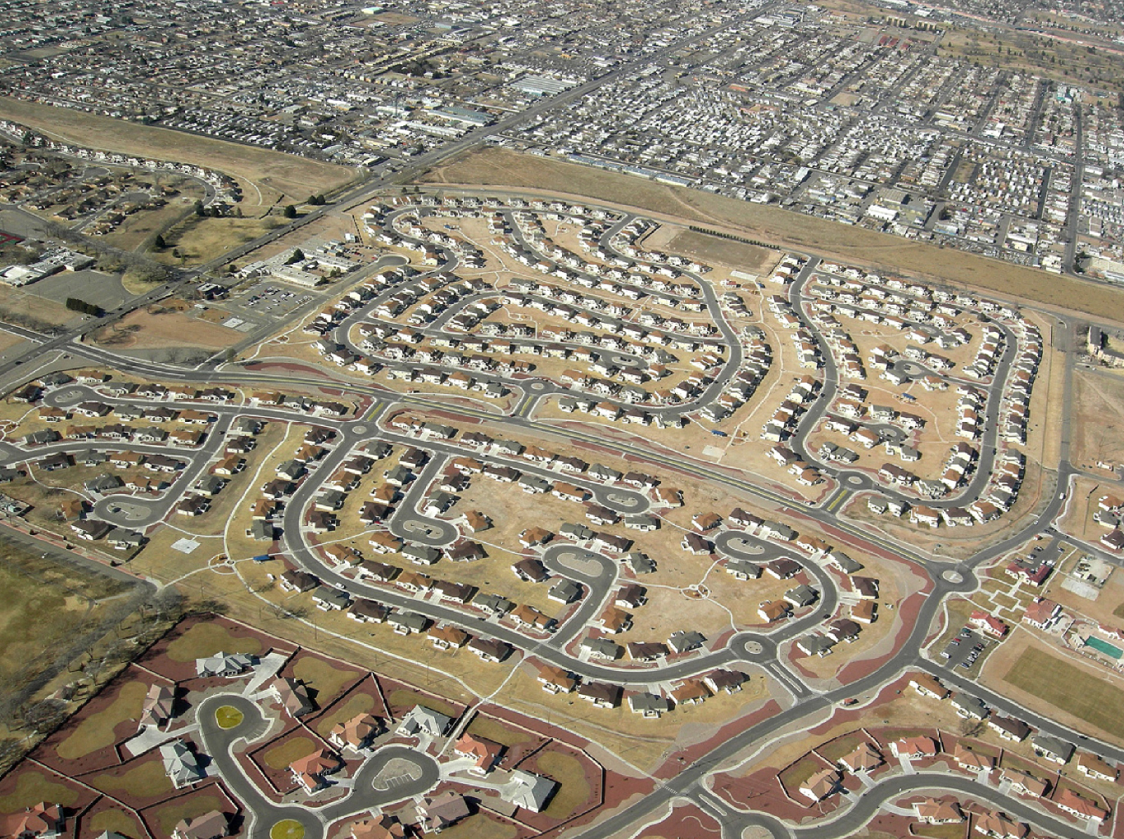
A Region On the Edge
Much of the region already receives only marginal precipitation
Just enough snow to support forests and reservoirs
Just enough irrigation water to support farming
Just enough water to support 5.1 million people

Slide 13
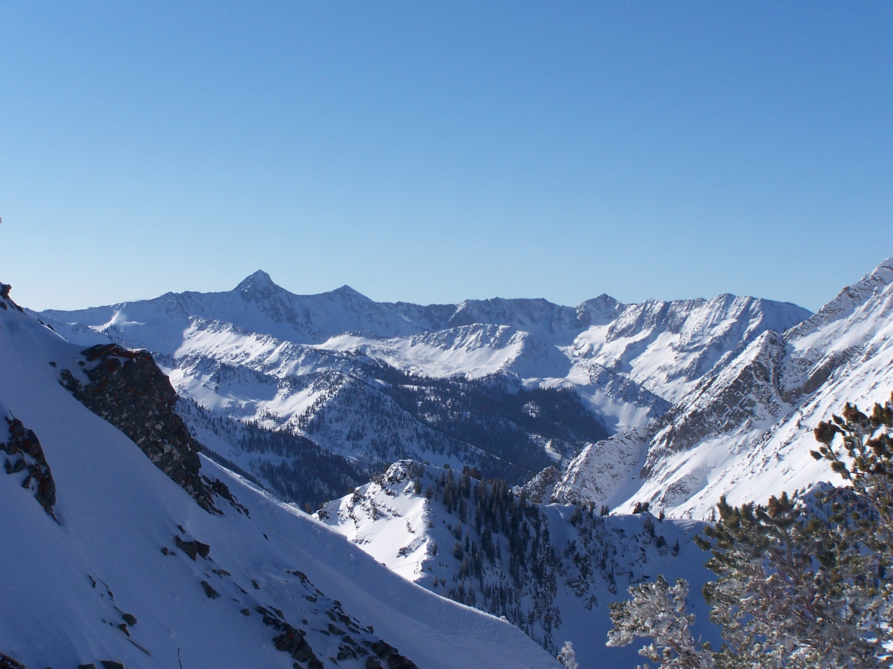
Ski Industry

Slide 14
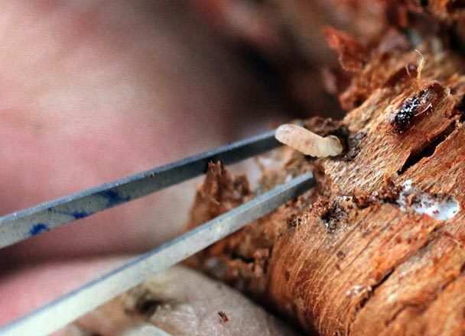
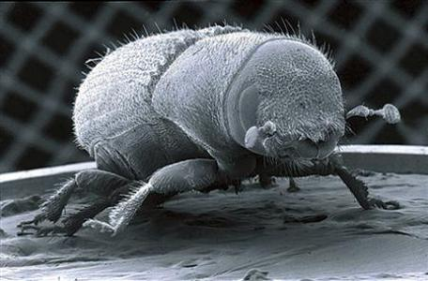
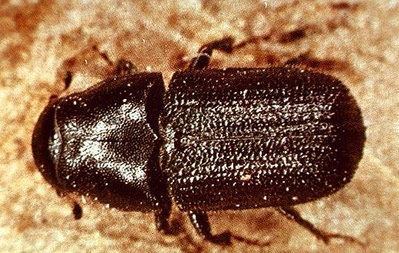
Mountain Pine Beetle

Slide 15
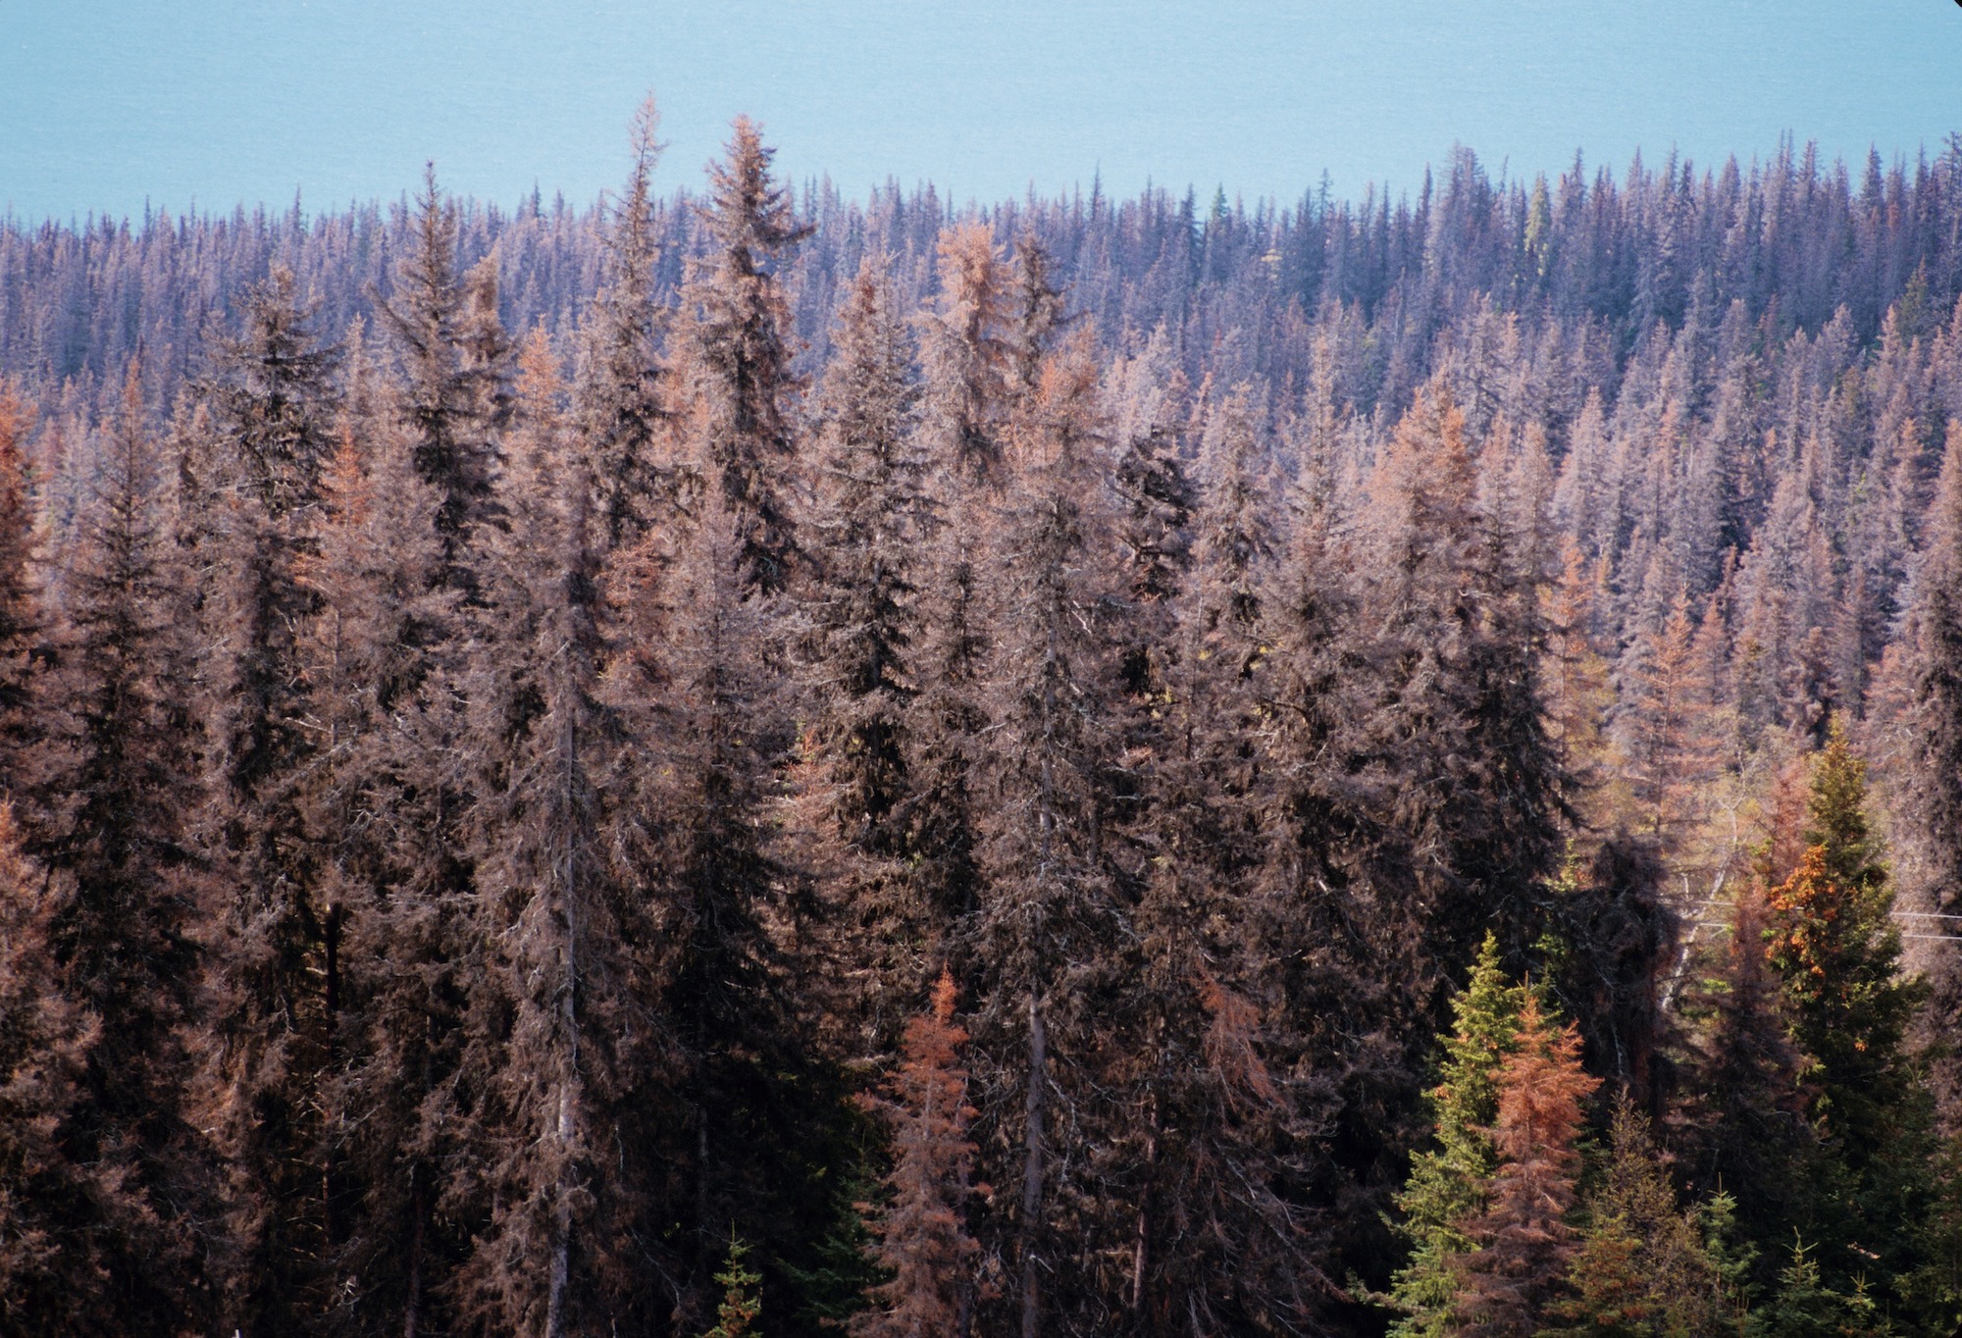
Insect Pests

Slide 16
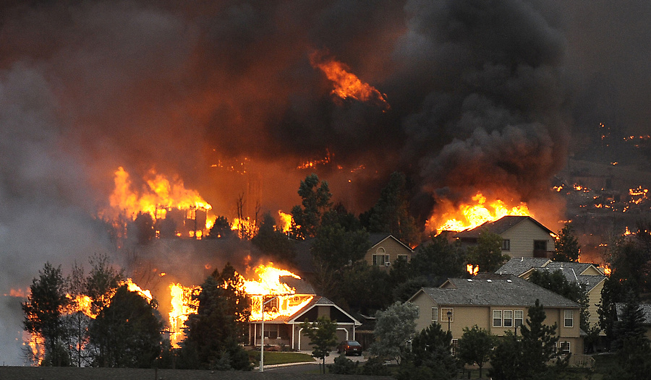
Wildfire

Slide 17
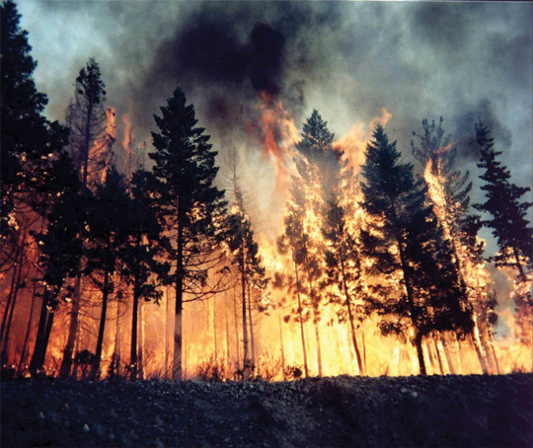
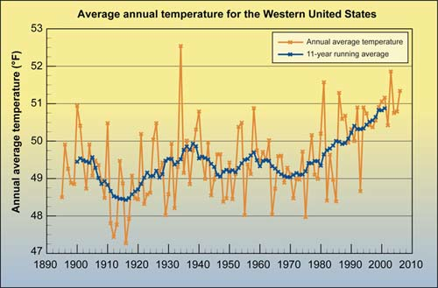
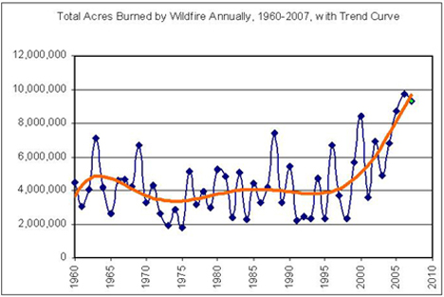
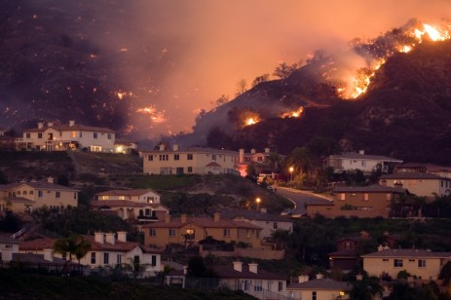
Western US Wildfires

Slide 18
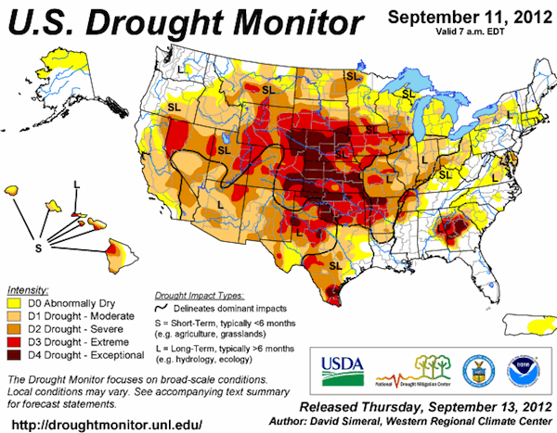

Slide 19
We Know for Sure
CO2 molecules absorb & re-emit thermal radiation (John Tyndall, 1863)
Each doubling of the number of CO2 molecules would add 4 W m⁻² to the Earth 24/7 (Svante Arrhenius, 1896)
If China and India industrialize with coal, CO2 will approach 400% preindustrial by 2100 (so 8 Watts, not 4, on each sq m)
Additional CO2 will continue adding heat to Earth for thousands of years

Slide 20
What We’re
Not So Sure About
When and precisely how the climate will change, especially locally
The economic, political, and social consequences of these changes
What to do about all of this

Slide 21
Choose Your Future
Some people think:
  “Our modern lifestyle is only possible because of the subsidy of cheap fossil fuel. When we stop burning coal we’ll freeze in the dark!”
I prefer:
  “Our well-being depends on creativity and hard work. Before we run out of oil, we’ll invent energy technologies for the 21st Century.
  Our future is bright.”

